Slide 1
Six Human Emotions Detection App

Slide 2
Overview
Web application for detecting six human emotions
Uses machine learning
Built with Streamlit

Slide 3
Emotions Detected
Joy
Fear
Anger
Love
Sadness
Surprise

Slide 4
Technical Stack
Python
Streamlit
scikit-learn (version 1.3.2)
NumPy
NLTK
TensorFlow (version 2.15.0)

Slide 5
Key Components
Logistic Regression Model
TF-IDF Vectorizer
Label Encoder

Slide 6
Text Processing
Cleaning: Remove non-alphabetic characters
Lowercasing
Tokenization
Stopword Removal

Slide 7
Prediction Process
Clean input text
Vectorize using TF-IDF
Predict using Logistic Regression
Decode label to emotion

Slide 8
User Interface
Simple text input box
"Predict" button
Displays predicted emotion and probability

Slide 9
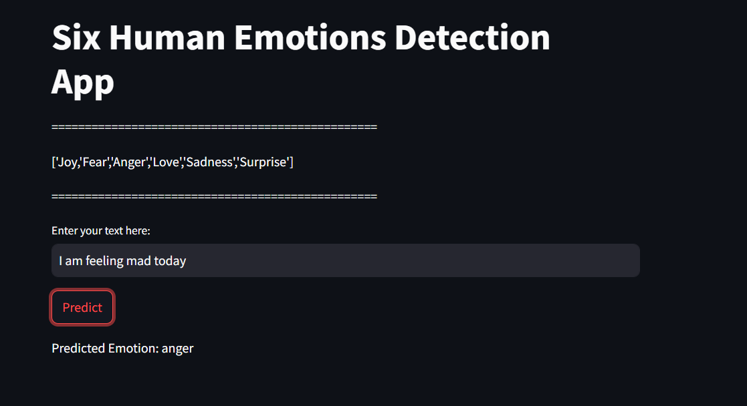
How to Use
Enter text in the input box
Click "Predict" button
View predicted emotion and probability

Slide 10
THANK YOU

